Slide 1
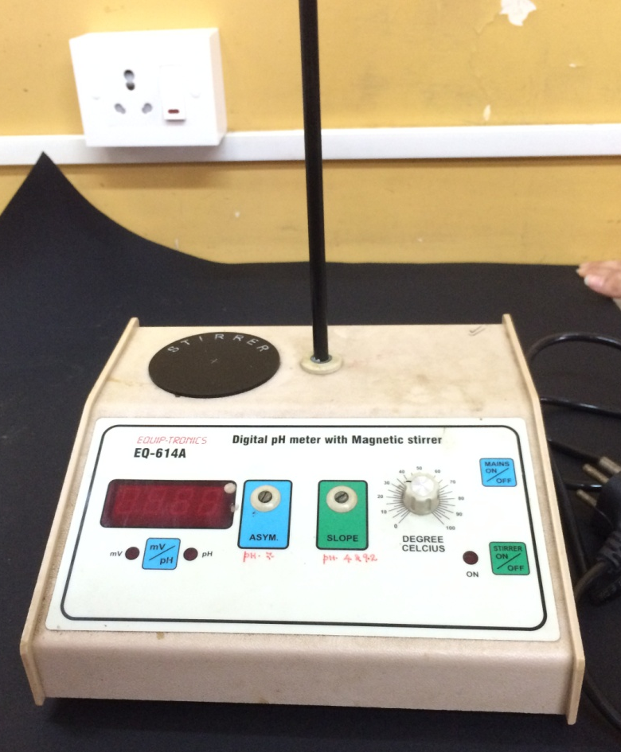
STANDARD OPERATING PROCEDURE (SOP) OF DIGITAL pH METER
MAIN BODY OF DIGITAL pH METER WITHOUT ELECTRODE

Slide 2
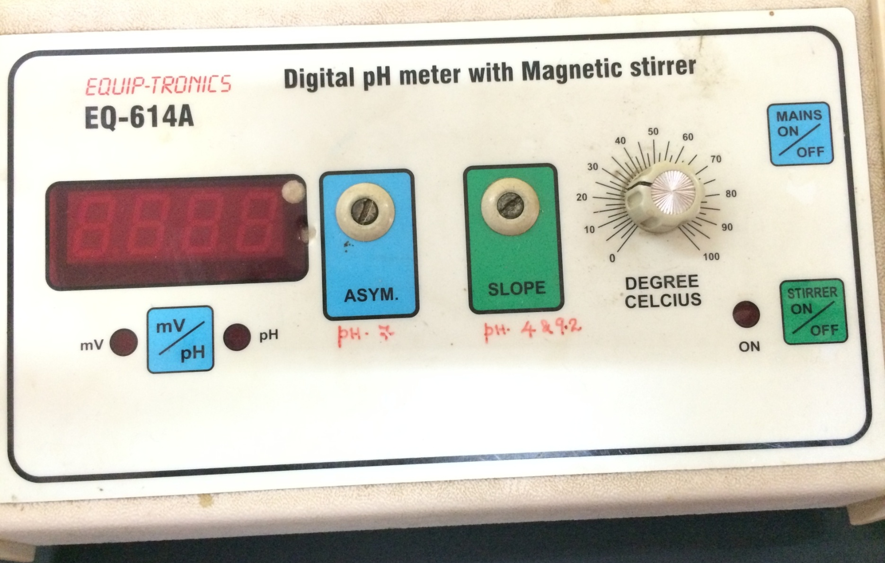
STANDARD OPERATING PROCEDURE (SOP) OF DIGITAL pH METER
FRONT PROFILE OF DIGITAL pH METER

Slide 3
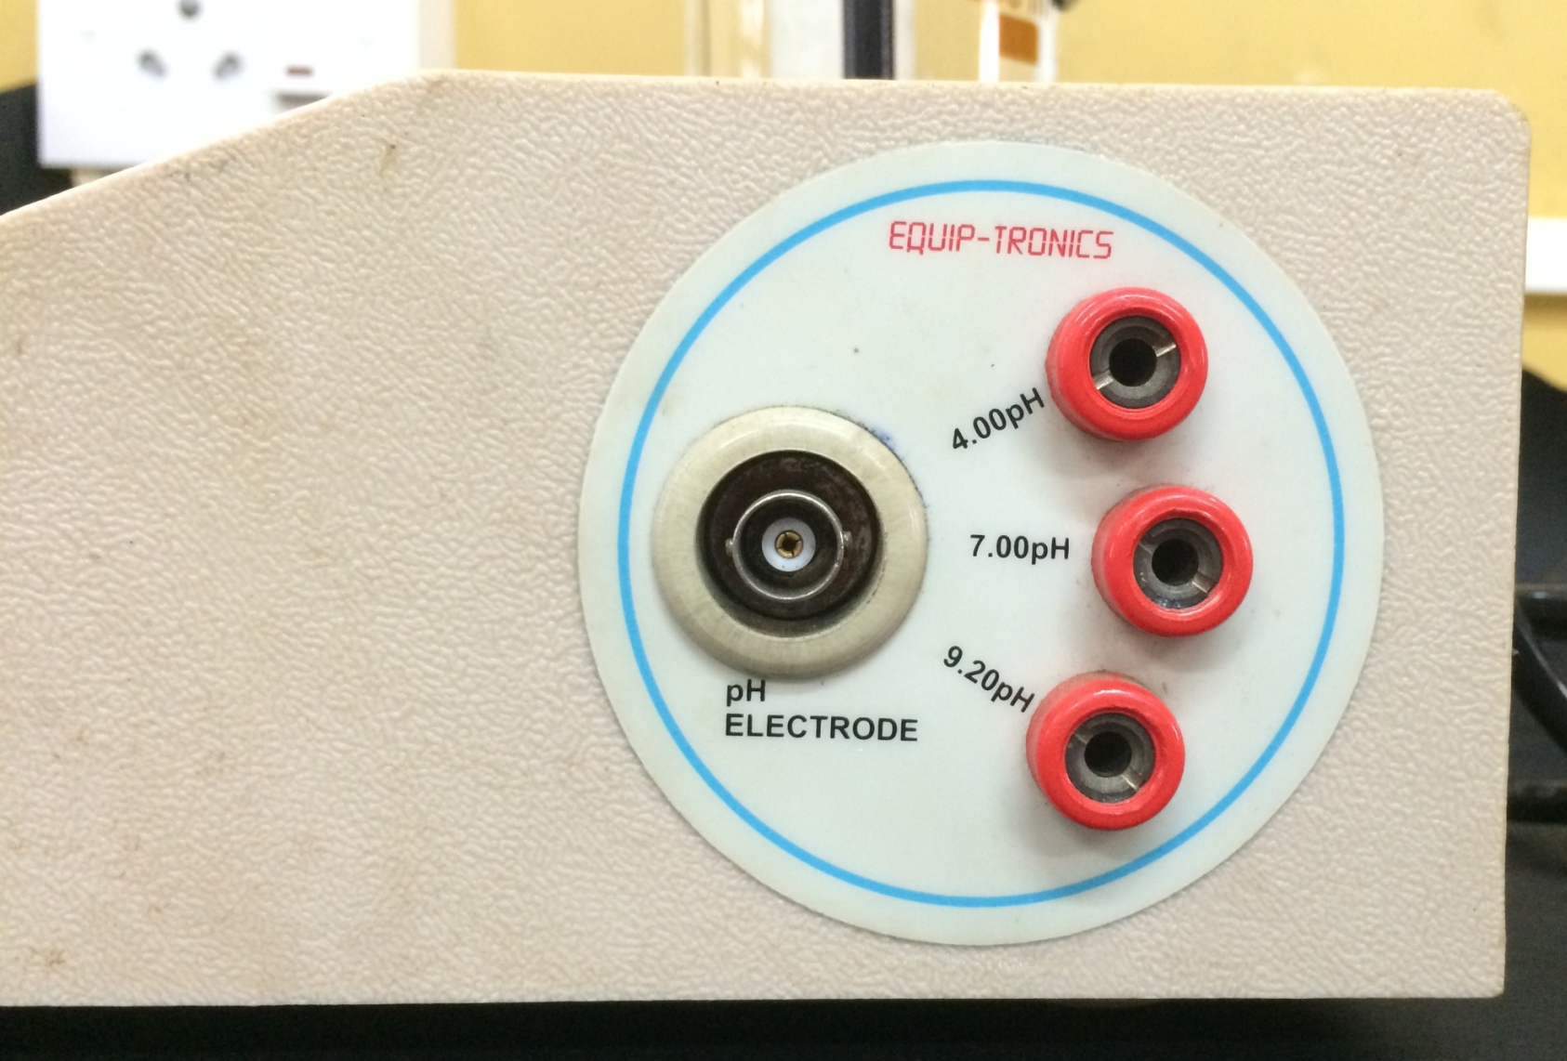
STANDARD OPERATING PROCEDURE (SOP) OF DIGITAL pH METER
SIDE PROFILE OF DIGITAL pH METER

Slide 4
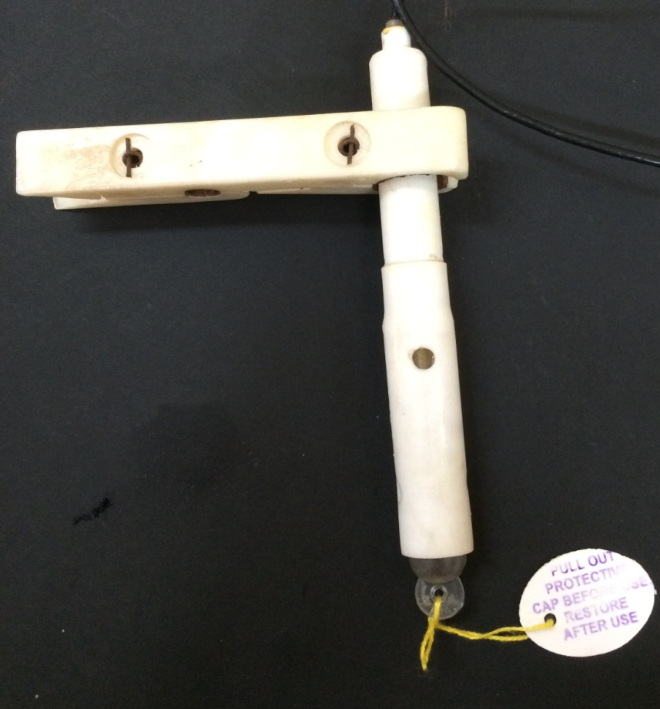
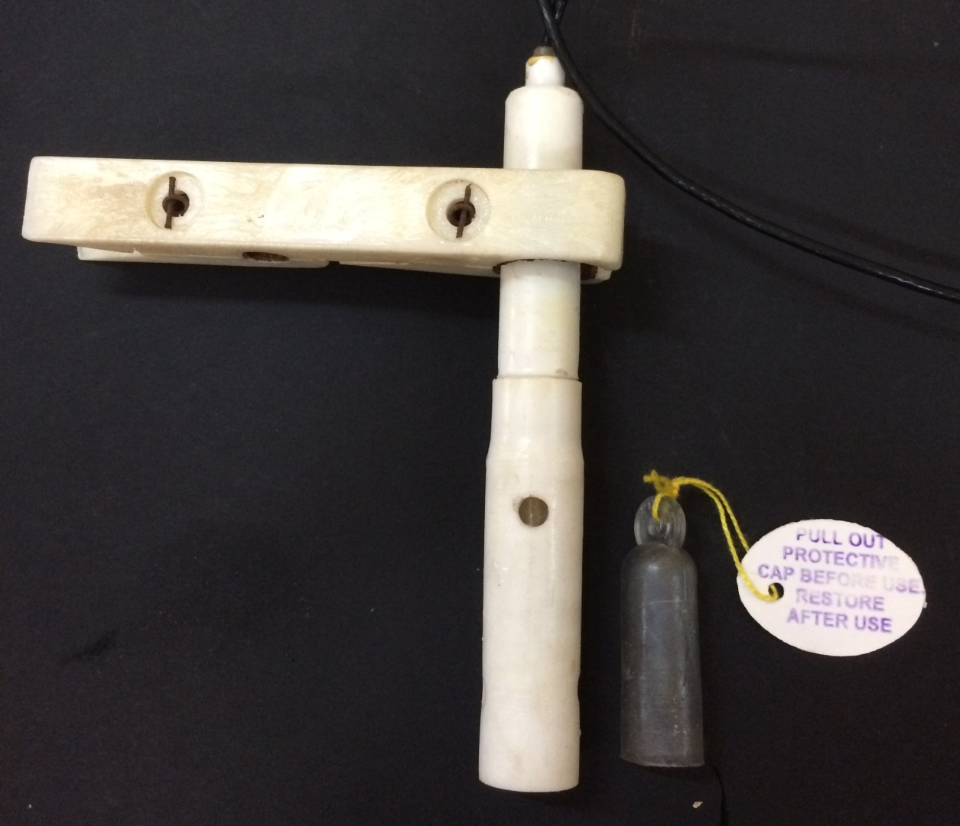
STANDARD OPERATING PROCEDURE (SOP) OF DIGITAL pH METER
ELECTRODE OF DIGITAL pH METER
WITH PROTECTIVE CAP
WITHOUT PROTECTIVE CAP

Slide 5
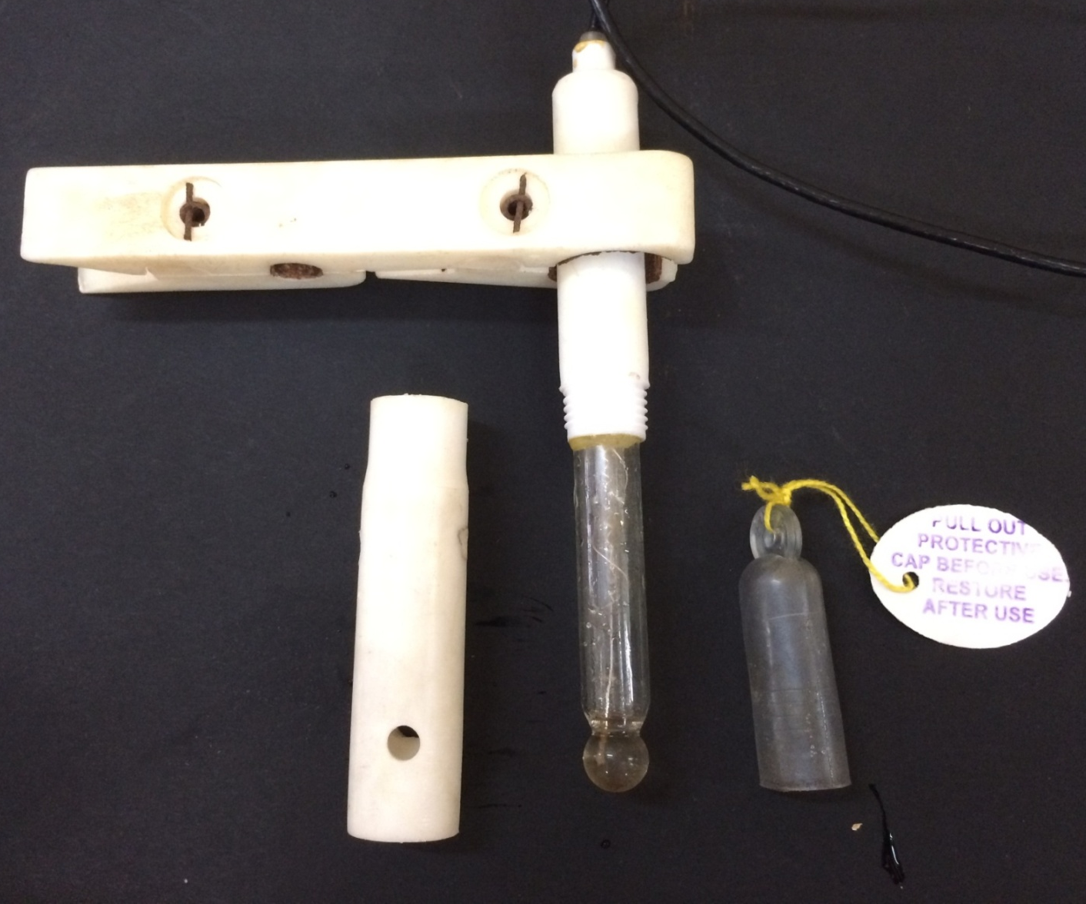
STANDARD OPERATING PROCEDURE (SOP) OF DIGITAL pH METER
ELECTRODE OF DIGITAL pH METER
PLASTIC PROTECTIVE BODY REMOVED TO EXPOSE GLASS ELECTRODE

Slide 6
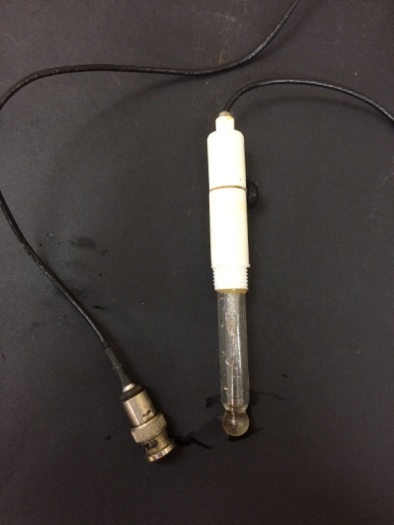
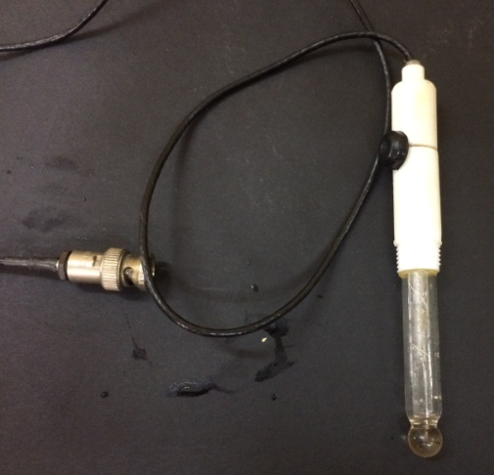
STANDARD OPERATING PROCEDURE (SOP) OF DIGITAL pH METER
ELECTRODE OF DIGITAL pH METER
EXPOSED GLASS ELECTRODE WITHOUT PLASTIC BODY AND CLAMP

Slide 7
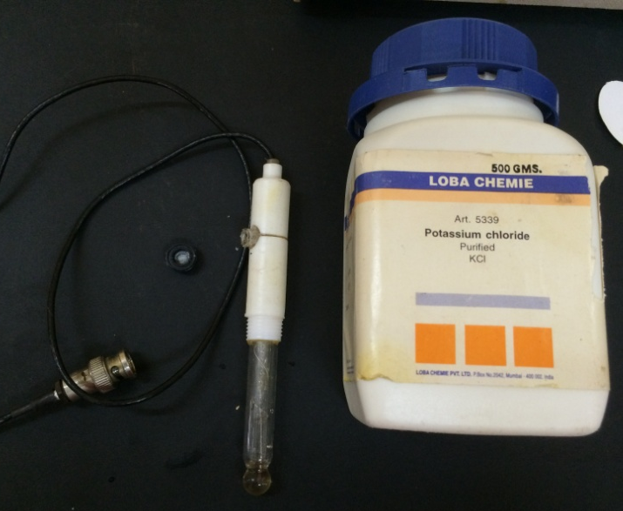
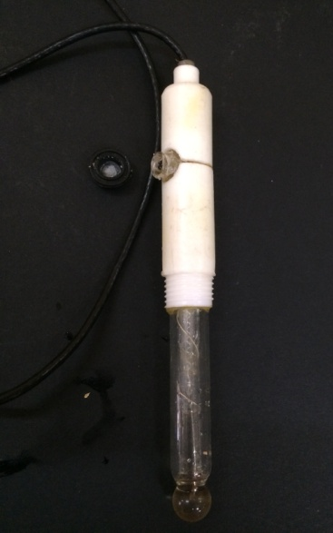
STANDARD OPERATING PROCEDURE (SOP) OF DIGITAL pH METER
ELECTRODE OF DIGITAL pH METER
EXPOSED GLASS ELECTRODE WITHOUT PLASTIC BODY AND CLAMP SHOWING APERTURE FOR ADDING POTASSIUM CHLORIDE

Slide 8
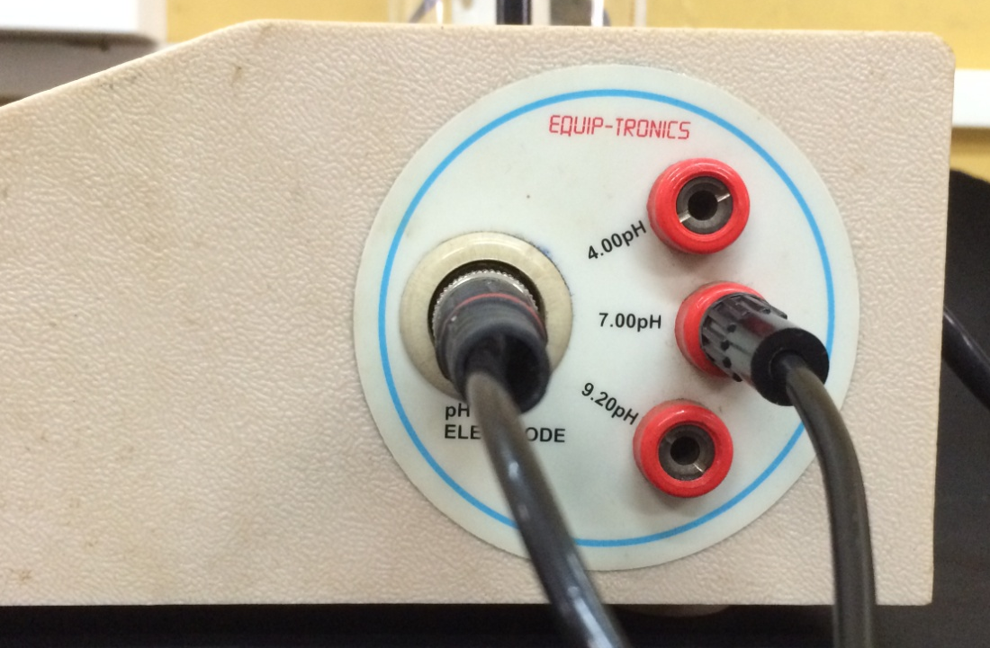
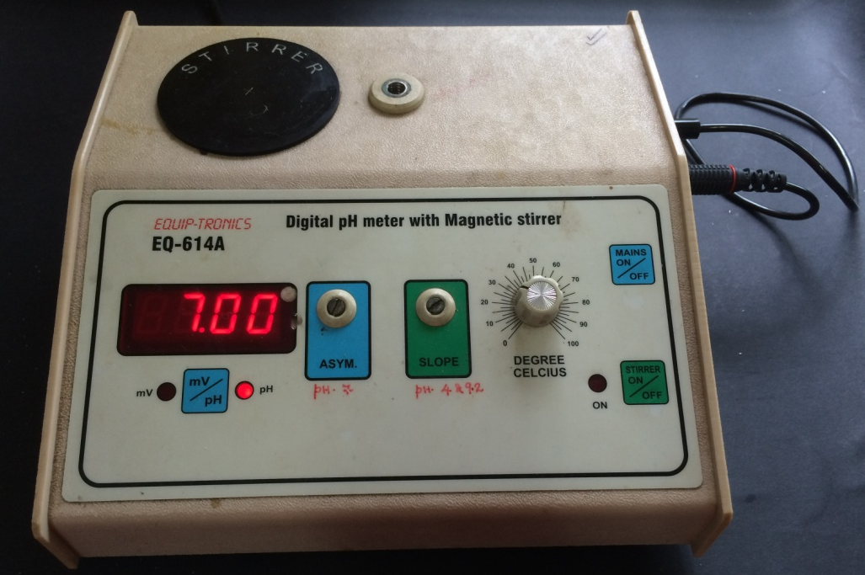
STANDARD OPERATING PROCEDURE (SOP) OF DIGITAL pH METER
CALIBRATION OF DIGITAL pH METER WITHOUT ELECTRODE

Slide 9
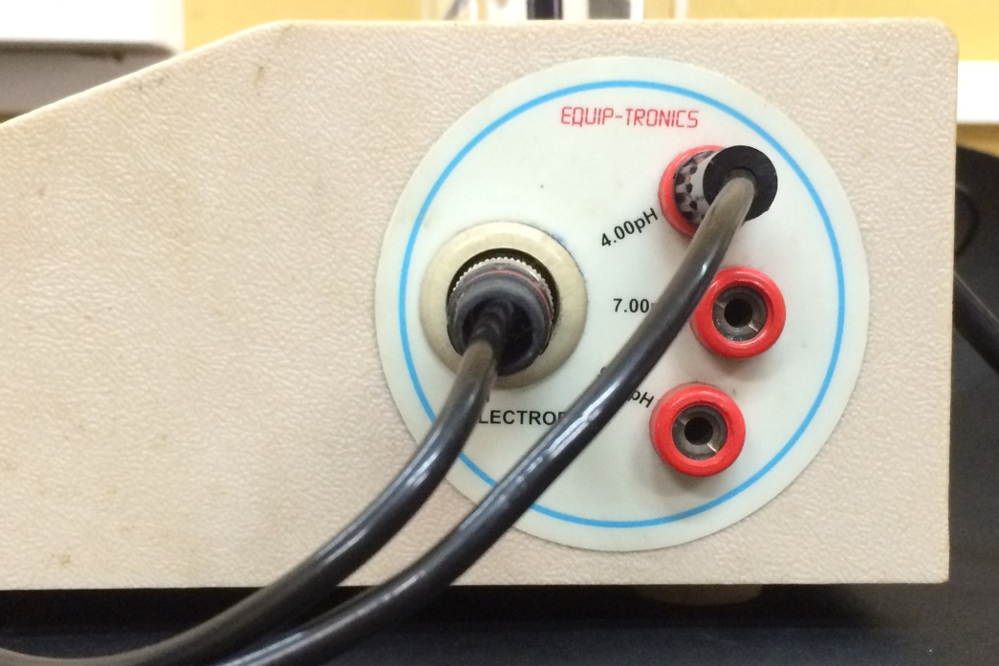
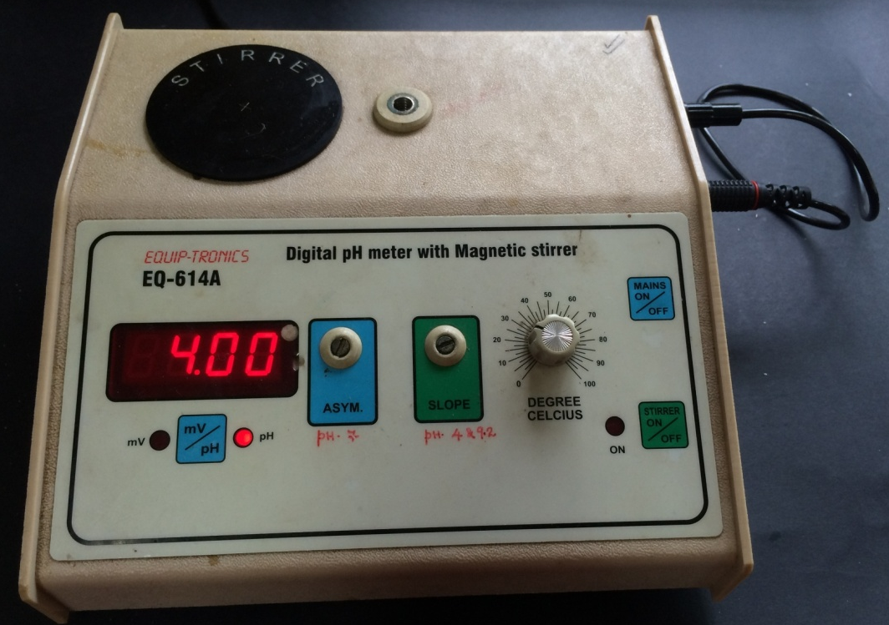
STANDARD OPERATING PROCEDURE (SOP) OF DIGITAL pH METER
CALIBRATION OF DIGITAL pH METER WITHOUT ELECTRODE

Slide 10
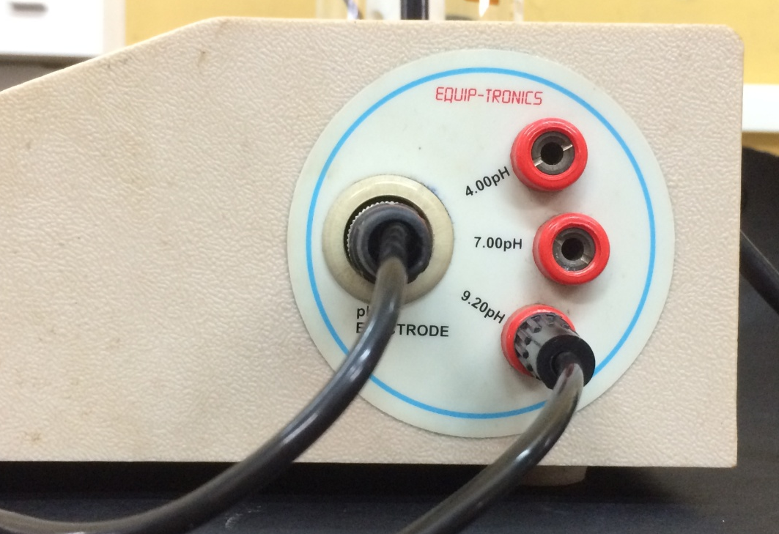
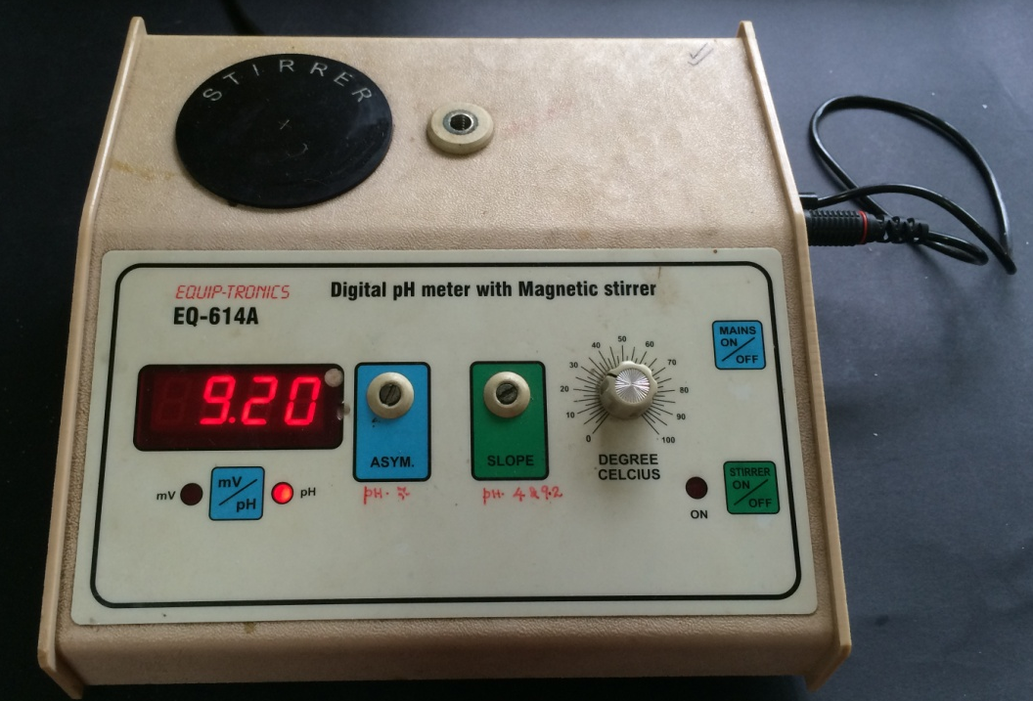
STANDARD OPERATING PROCEDURE (SOP) OF DIGITAL pH METER
CALIBRATION OF DIGITAL pH METER WITHOUT ELECTRODE

Slide 11
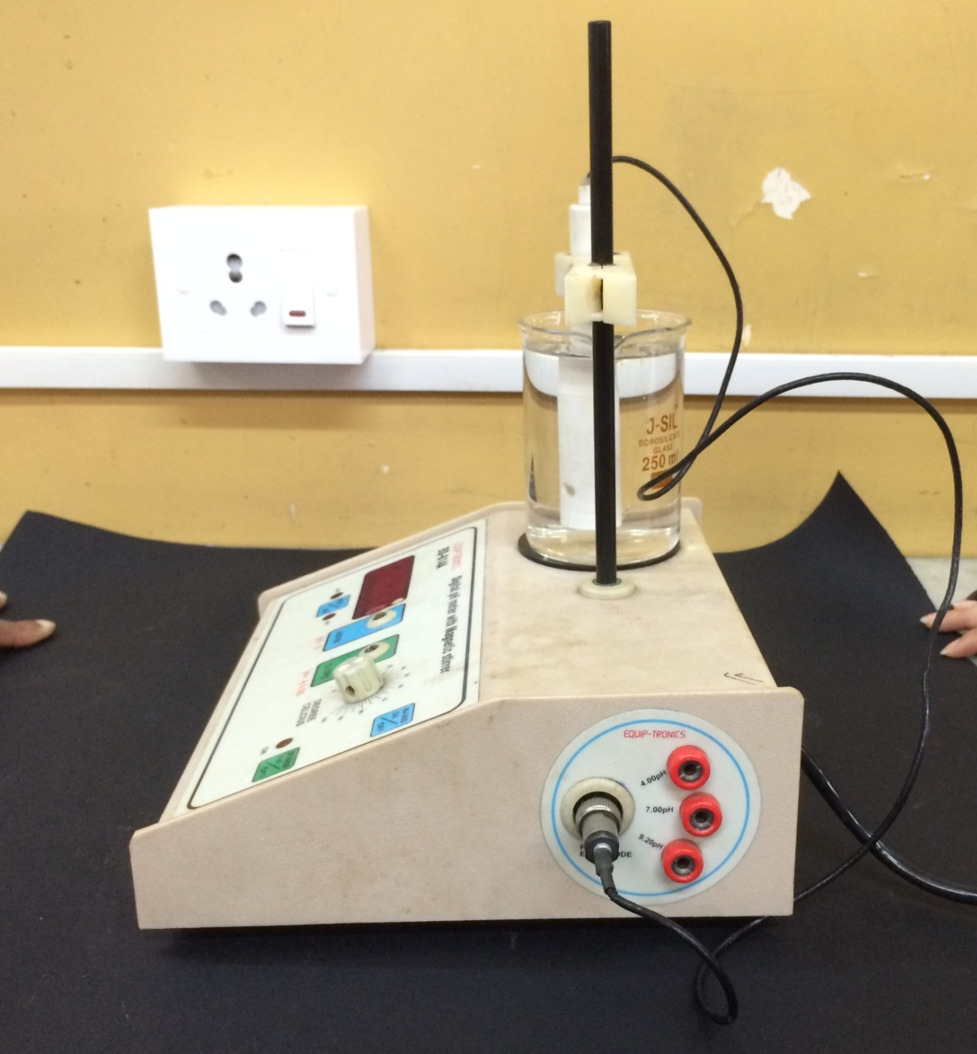
STANDARD OPERATING PROCEDURE (SOP) OF DIGITAL pH METER
ATTACHMENT OF ELECTRODE TO THE DIGITAL pH METER

Slide 12
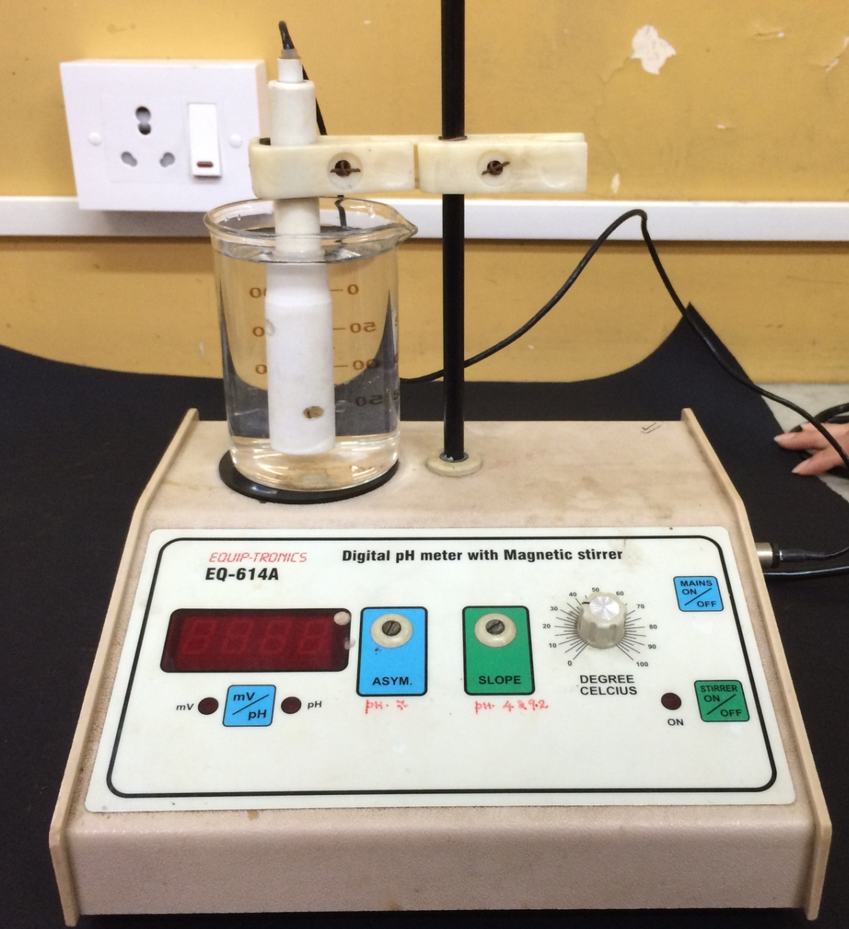
STANDARD OPERATING PROCEDURE (SOP) OF DIGITAL pH METER
DIGITAL pH METER WITH ELECTRODE IMMERSED IN DISTILLED WATER

Slide 13
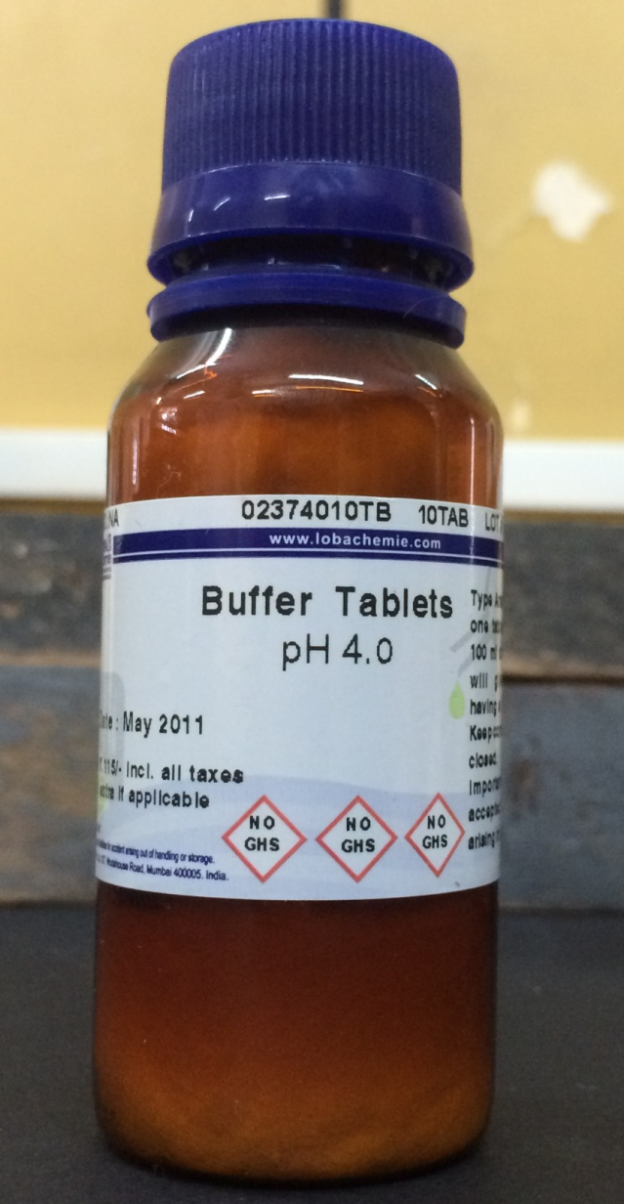
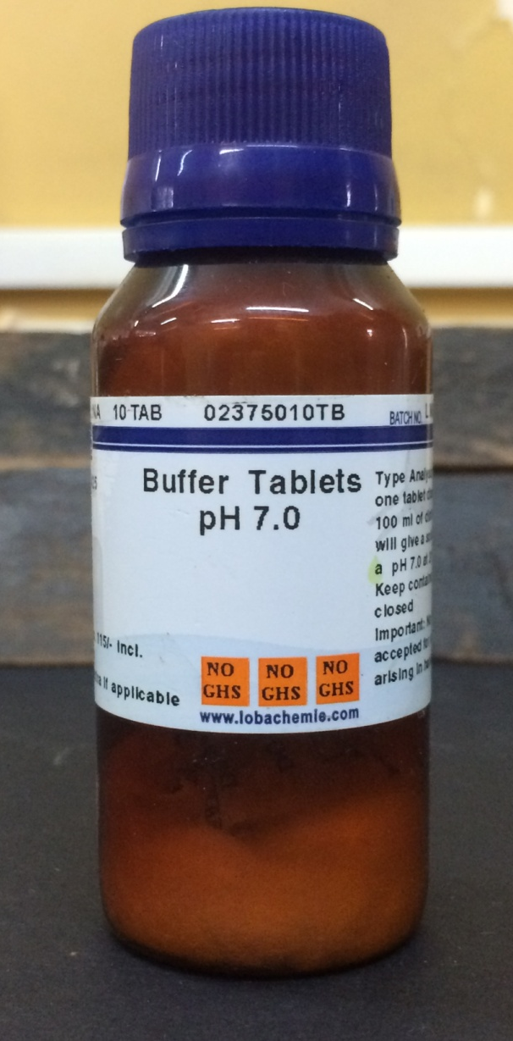
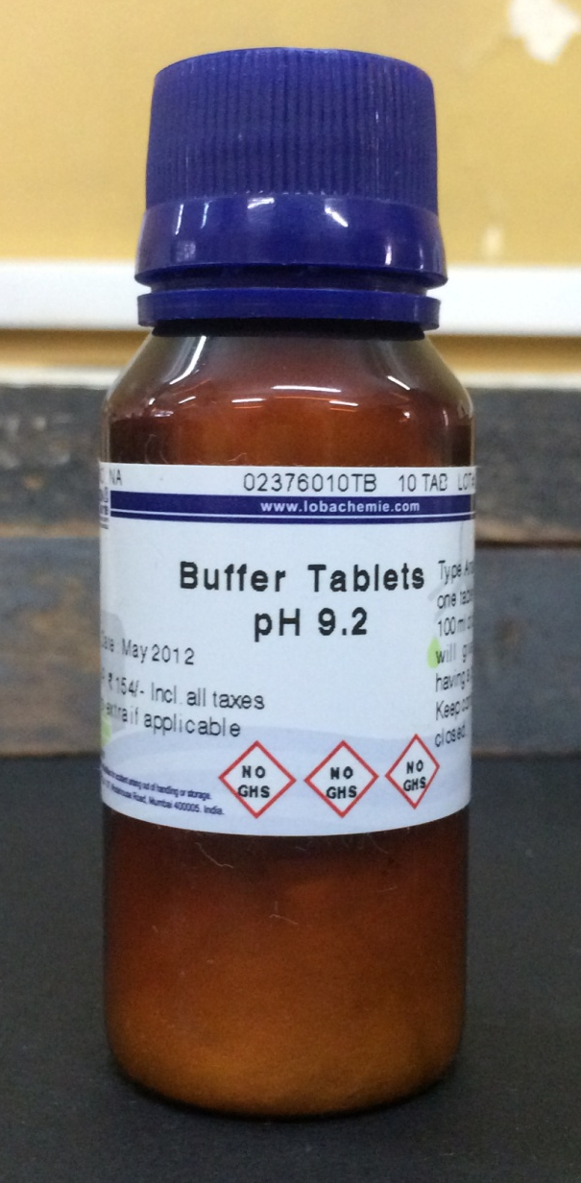
STANDARD OPERATING PROCEDURE (SOP) OF DIGITAL pH METER
CALIBRATION OF DIGITAL pH METER BY USING BUFFER TABLETS

Slide 14
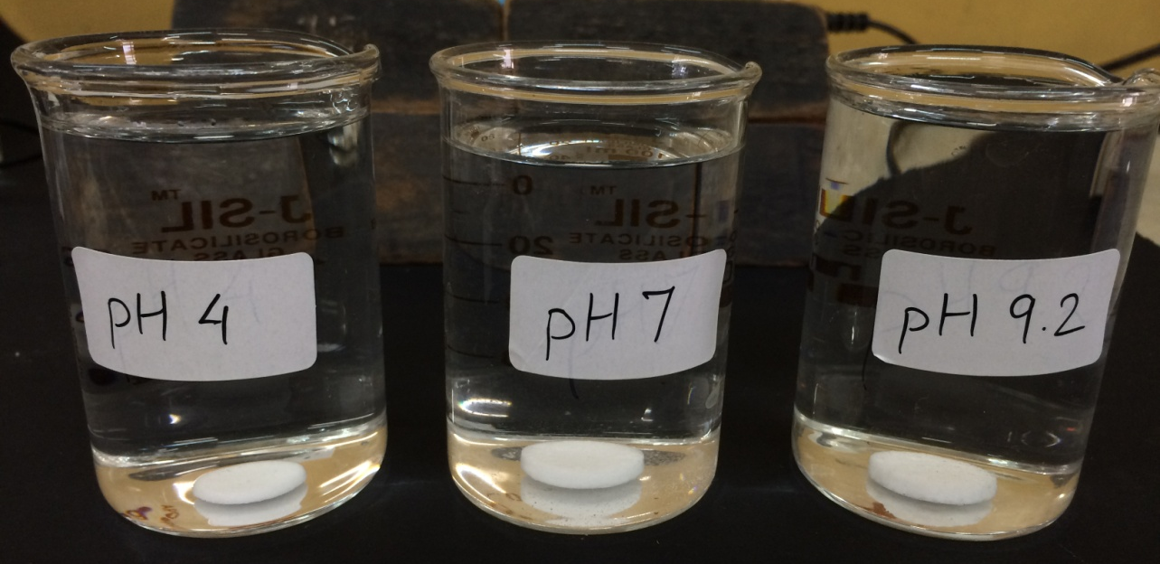
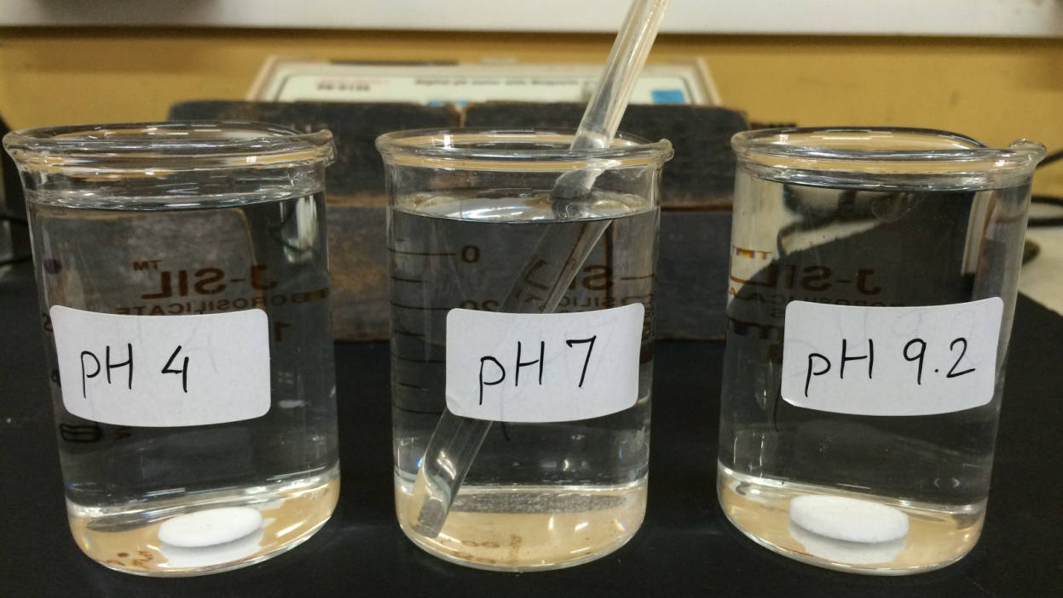
STANDARD OPERATING PROCEDURE (SOP) OF DIGITAL pH METER
CALIBRATION OF DIGITAL pH METER USING BUFFER TABLETS

Slide 15
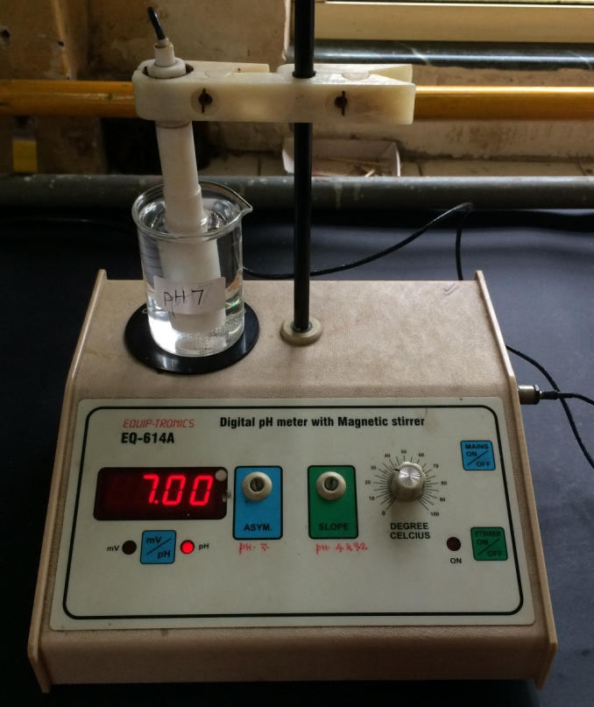
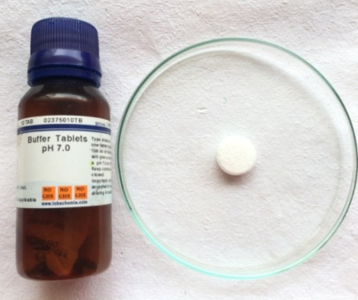

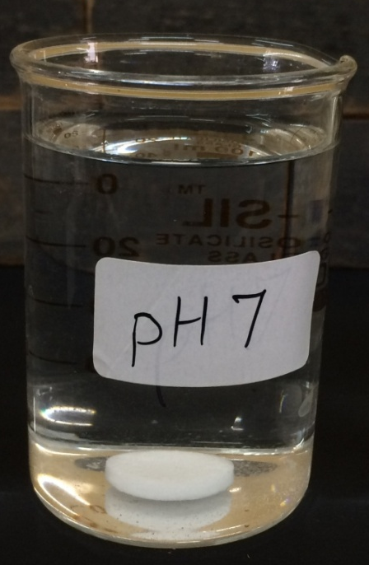
STANDARD OPERATING PROCEDURE (SOP) OF DIGITAL pH METER
CALIBRATION OF DIGITAL pH METER USING BUFFER TABLETS
Potassium dihydrogen phosphate

Slide 16
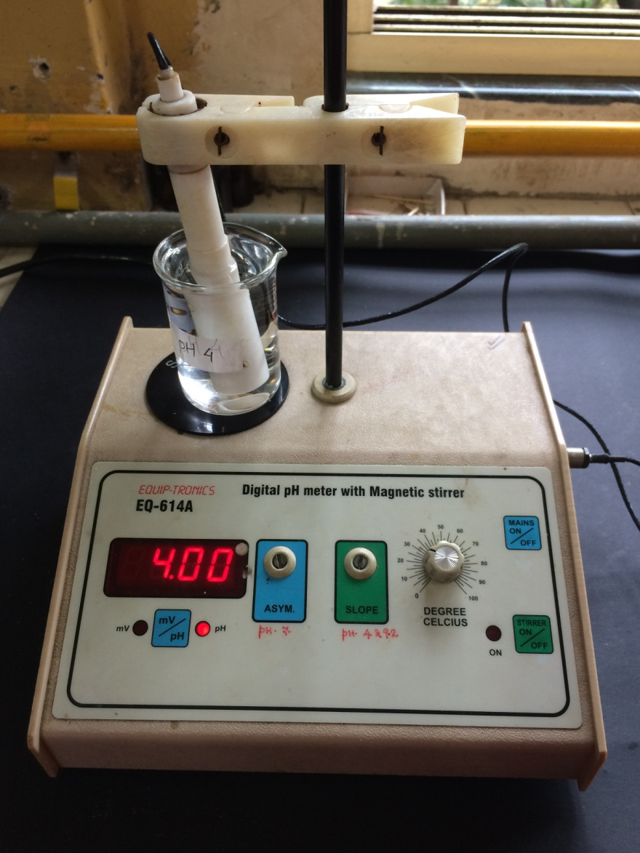
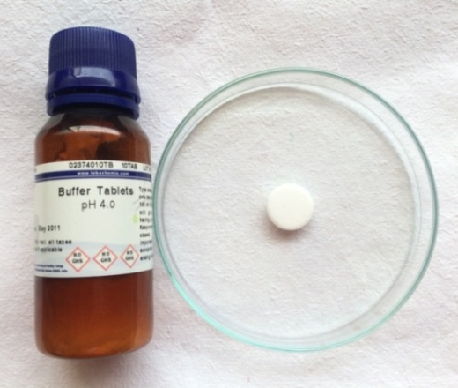

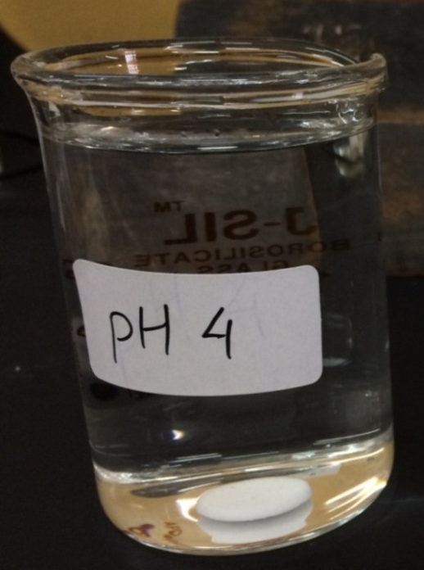
STANDARD OPERATING PROCEDURE (SOP) OF DIGITAL pH METER
CALIBRATION OF DIGITAL pH METER USING BUFFER TABLETS
Potassium hydrogen phthalate

Slide 17
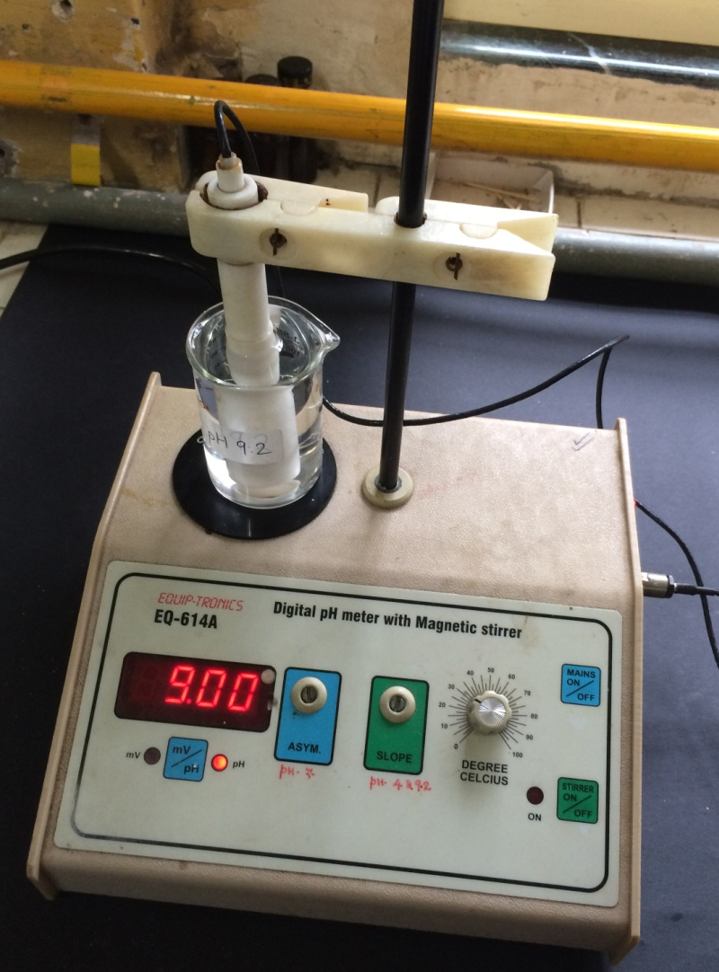
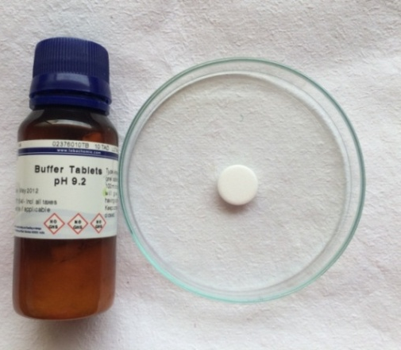


STANDARD OPERATING PROCEDURE (SOP) OF DIGITAL pH METER
CALIBRATION OF DIGITAL pH METER USING BUFFER TABLETS
Boric acid

Slide 18
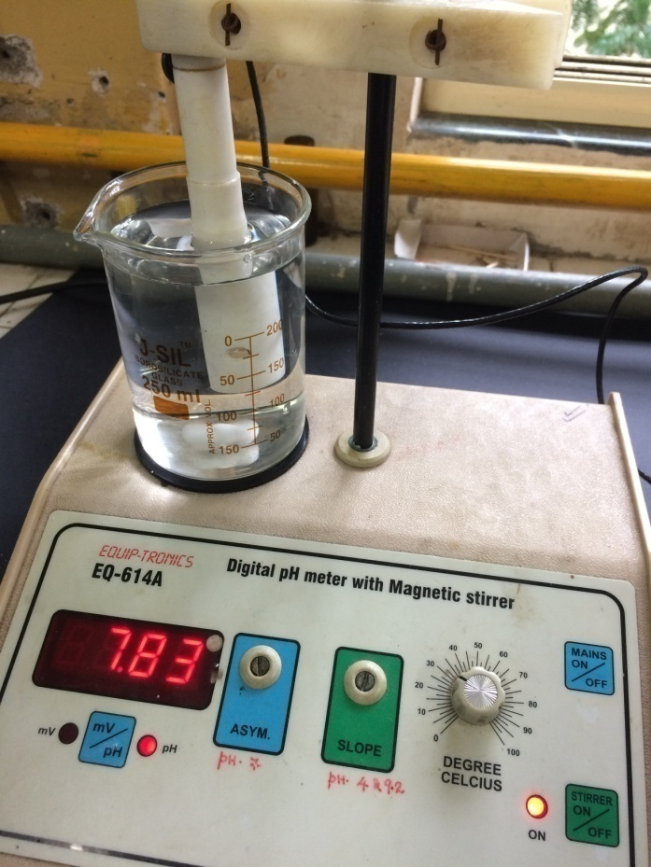
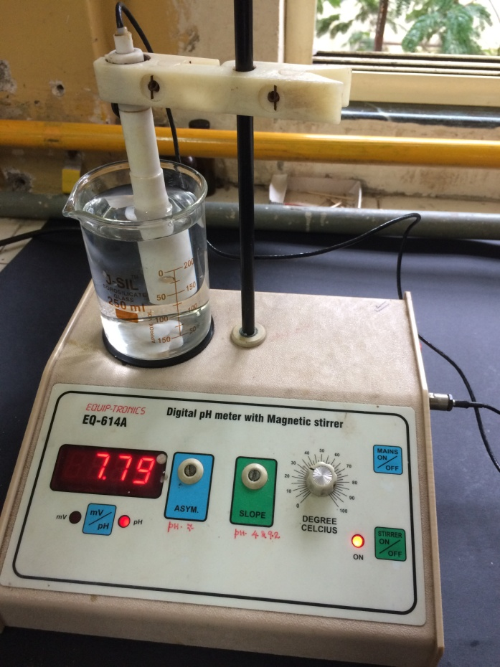
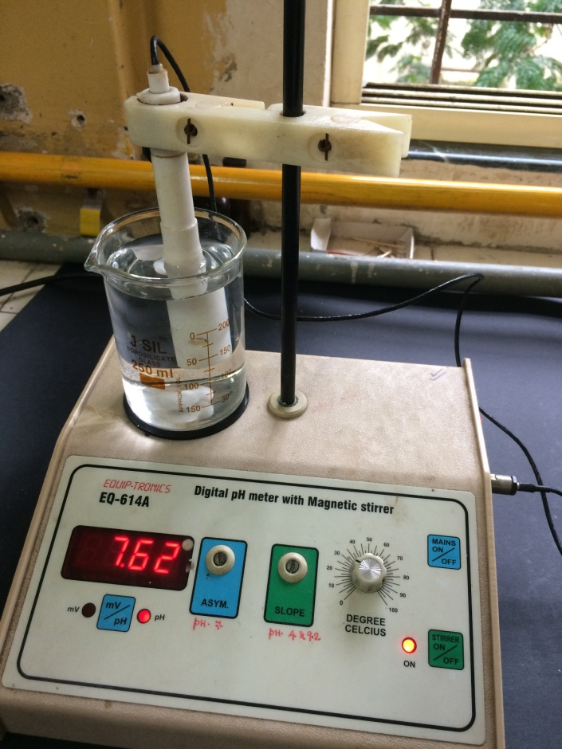
STANDARD OPERATING PROCEDURE (SOP) OF DIGITAL pH METER
DIGITAL pH METER WITH ELECTRODE BEING FLUSHED IN DISTILLED WATER BY USING MAGNETIC STIRRER

Slide 19
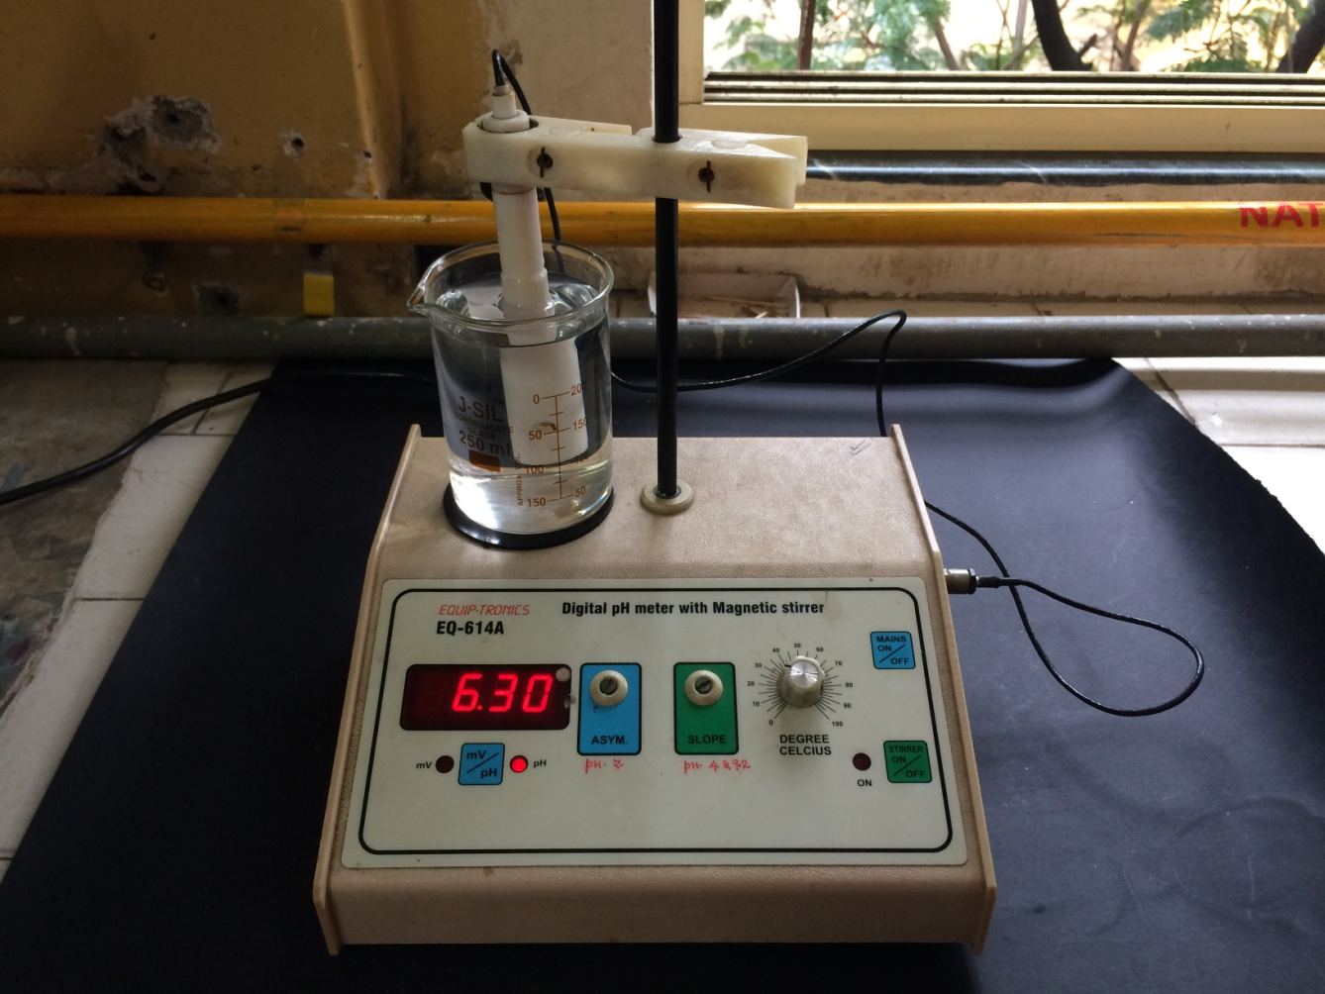
STANDARD OPERATING PROCEDURE (SOP) OF DIGITAL pH METER
DIGITAL pH METER WITH ELECTRODE IMMERSED IN DISTILLED WATER

